Slide 1

Research Policies and Procedures
of the Navajo Nation Human Research Review Board (NNHRRB)
http://www.nnhrrb.gov
928-871-6929
928-871-6255 (fax)

Slide 2
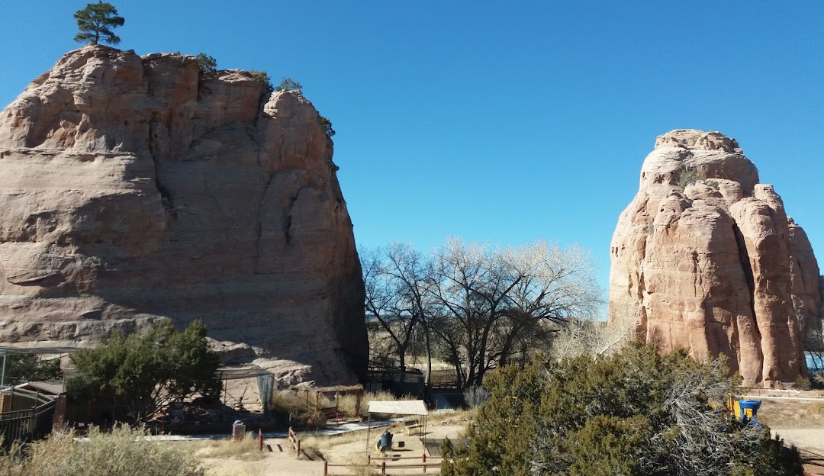
NAVAJO NATION HUMAN RESEARCH REVIEW BOARD
“Indigenous people and researchers: building collaborative partnerships and the importance of responsibilities, ethics, and values of research on the Navajo Nation”

Slide 3
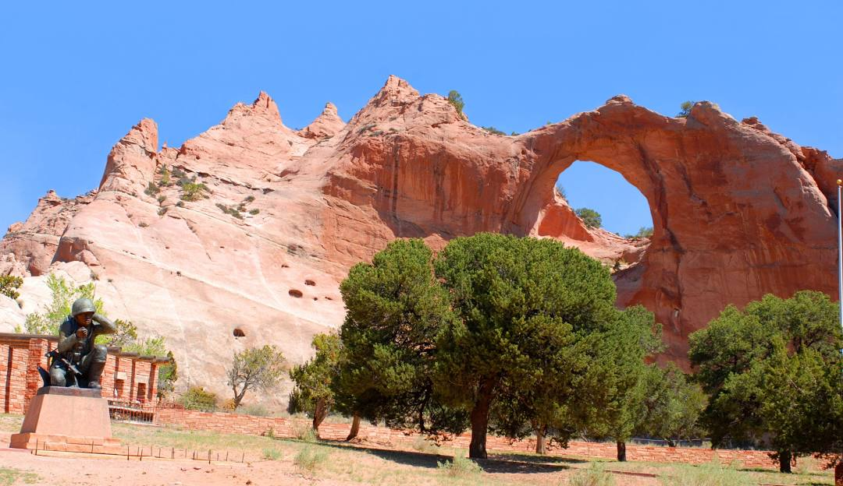
NHRRB Mission
To support research that promotes and enhances the interests and the visions of the Navajo people; to encourage a mutual and beneficial partnership between the Navajo people and researchers; and to create an interface where difference cultures, lifestyles, disciplines, and ideologies can come together in a way that improves, promotes, and strengthens the health of the Navajo people.

Slide 4



Navajo IRB History
Belmont Report:
Ethical principles for
human subject research
1978
Belmont Report released
respect
1979
IHS forms Navajo Area IHS IRB
justice
beneficence
1991
IHS establishes National IHS IRB
1992
Navajo Nation assumes self-governance to operate NAIHS IRB
Navajo Research Code
Conditions under which health/health-related research activities may be conducted to ensure all persons within the territorial jurisdiction of the Navajo Nation are free from harmful, intrusive, ill-conceived or otherwise offensive research and investigation procedures.
1995
Navajo Nation Council enacts Navajo Nation Research Code
1996
NNHRRB begins reviewing study proposals
2002
Navajo Nation Council expands NNHRRB authority to review, monitor & approve research

Slide 5
NAVAJO NATION HUMAN RESEARCH
REVIEW BOARD MEMBERS
(Navajo Nation IRB Federal Wide Assurance (FWA) # IRB00000641, I.H.S. #8) Expires 5-26-2027
For Protection of Human Subjects for Institutions. DHHS
OPVP
2024-2027
NAIHS
2024-2027
HEHSC
2025-2028
Dr. Sonya Shin, MD, MPH
Pro-Temp Chair
Medicine, Public Health
Delvin Yazzie, MPH
Epidemiology
Dr. Nanibaa’ Garrison, PhD
Bioethics and Genetics
Dr. Christopher Jentoft, MD
Medicine, Clinical Director
Dr. Emily Bartlett, MD
Emergency Medicine
Dr. Paula Mora, MD
Medicine, Public Health,
Chief Medical Officer
B. Alex Montoya, BCH
Community Health Education,
Navajo Culture
Dr. Christine Samuel, PhD
Nursing, Education
Floyd Ashley, MA
Scientific Education
Jonathan Hale, BS
Animal Science, Health Safety
Mae-Gilene Begay, MSW
Community Member, Public Health
Veronica Clark, MA, PhDc
Education, Nutrition
NDOH
TBD
Research Director
Mike Winney
IRB Coordinator
HEHSC – Health, Education and Human Service Community NN Council
NAIHS – Navajo Area Indian Health Service
NDOH - Navajo Department of Health
OPVP - Office of President and Vice-President

Slide 6
NHRRB Assets and Strengths
  Navajo people have possessed indigenous knowledge & science for over 1000 years
  National and international reputation as a leader of tribal IRBs.
  Established relationships with academic institutions such as NAU, Johns Hopkins, U of A, UNM, U of Utah, ASU, Diné College, NTU.
  Dedicated group of volunteer Board members
  Monitors 220 open studies, 1770 closed studies in archives
  Data sovereignty: all research data belong to the Navajo Nation
  Bi-annual NNIRB Research Conference in Window Rock

Slide 7



Research Process
Prepare in advance * Carefully review NHRRB resources * Involve the community
Community partnership
Navajo co-PIs / co-investigators
Community involvement
Community & cultural advisors
Support Letters
Health Service Units / Facility CEO
NN / NIAHS Program Directors
School Superintendents
Permissions Resolutions
Navajo Agency Councils
Chapters
NN offices
Health and/or School Boards

Slide 8
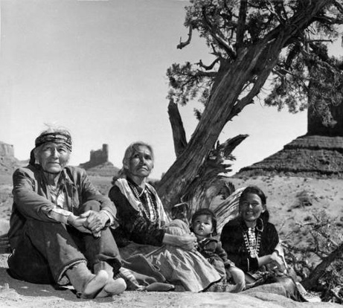
Navajo Nation Standards of Approval
  Community involvement
  Benefits to the Navajo Nation
  Authority of the Navajo Nation
  Research project description
  Informed consent form(s)
  Participant fliers, handouts
  Data collection forms
  Budget
  Principal Investigator certification

Slide 9
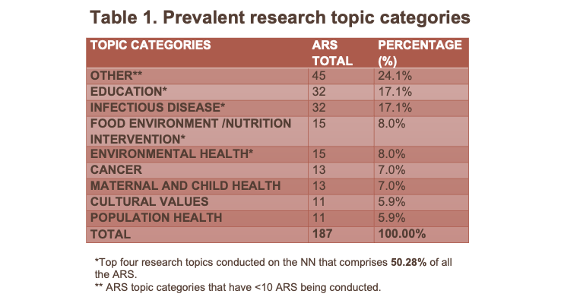
Navajo Research Studies
Jennifer Hudson, MPH
Health Promotion Student, NAU

Slide 10
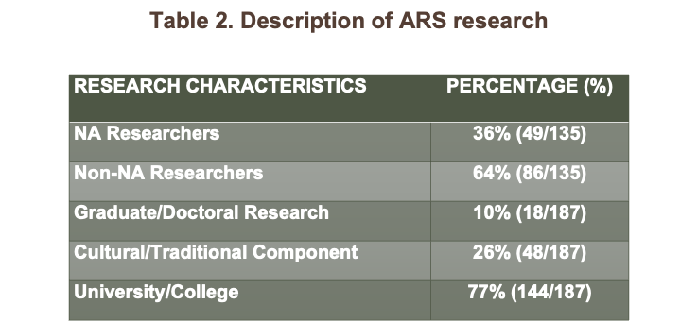
Navajo Research Studies
Jennifer Hudson, MPH
Health Promotion Student, NAU

Slide 11
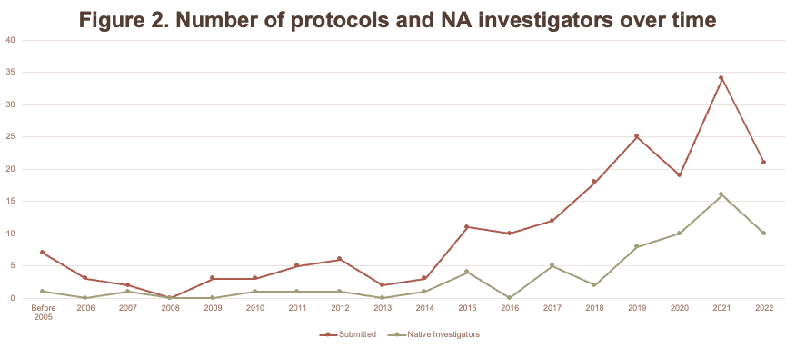
Navajo Research Studies
Jennifer Hudson, MPH
Health Promotion Student, NAU

Slide 12
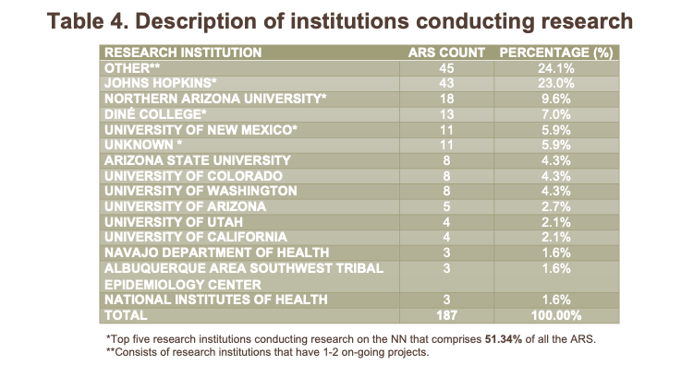
Navajo Research Studies
Jennifer Hudson, MPH
Health Promotion Student, NAU

Slide 13




Navajo Research Studies
Vaccine Trials (Dr. Hammitt)
H. pylori research (Dr. Pete)
Family Spirit (Johns Hopkins team)
Navajo Birth Cohort Study (UNM)

Slide 14




NHRRB: Looking ahead
Research Director, NDOH
Update NHRRRB Research Code
Exempt / expedited studies
Genetic Research Policy

Slide 15
In Closing…
The Navajo Nation exercises its authority by strengthening tribal sovereignty through the complex maze of federal, federal Indian, state and tribal policies.
The Navajo Research Code and NNHRRB reclaim and protect intellectual & cultural rights of their people and future generations.
NNHRRB processes and protocols demonstrate steps for respectful, transparent partnerships between community and researchers as we all work together to improve health outcomes for American Indian people.

Slide 16

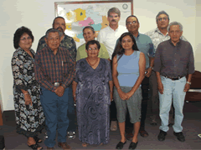
Navajo Nation Human Research Review Board
Promote “Expert Indians instead of Indian Experts”
Quote from NNHRRB Chair, Ms. Beverly Pigman, (June 27, 2006)

Slide 17

Contact:
Dr. Sonya Shin, Pro-Temp Chair
protempnhrrb@gmail.com
Mike Winney, IRB Coordinator
Navajo Nation Human Research Review Board
Navajo Department of Health
mrwinney@navajo-nsn.gov
(928) 871-6929

